Slide 1
Riverside Scotland: Operational KPIs (Board)
Period 12 - 28 February to 03 April 2022

Slide 2
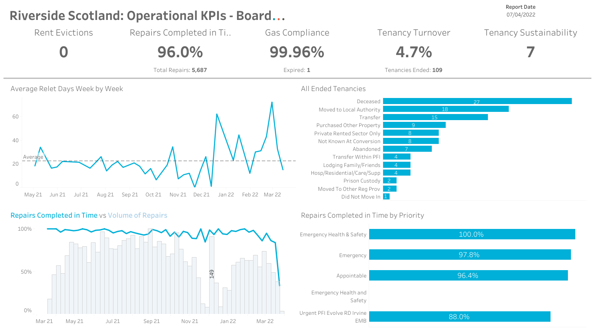

Slide 3
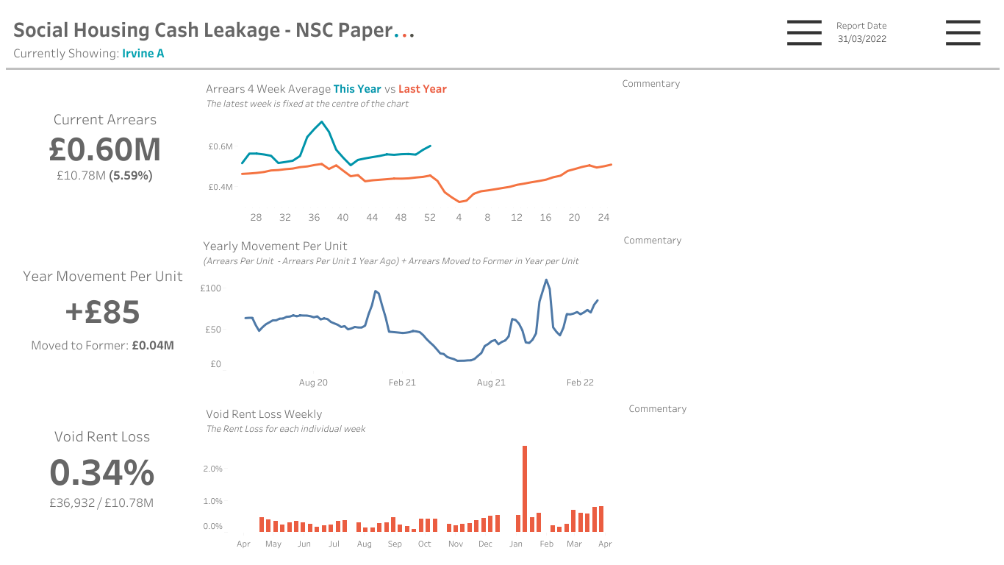
Void loss figure for wc 10/01/2022 showing erroneously as £6,078 due to a void input error (void start date was input as Jan 21 instead of Jan 22 so added full year void) this will be amended.

Slide 4
